Slide 1
Quantum Set Packing
A set packing problem solved with a quantum annealer

Slide 2
A brief overview over the quantum annealer
The quantum annealer used is accessible from this link. It is a controllable supercomputer that works at a temperature of approximately 12mK.
It aims to return a low-energy solution and it particularly fits optimization and sampling problems.
While the gate annealer requires problems to be expressed in terms of quantum gates, it requires them to be expressed in the language of operation research ones.

Slide 3
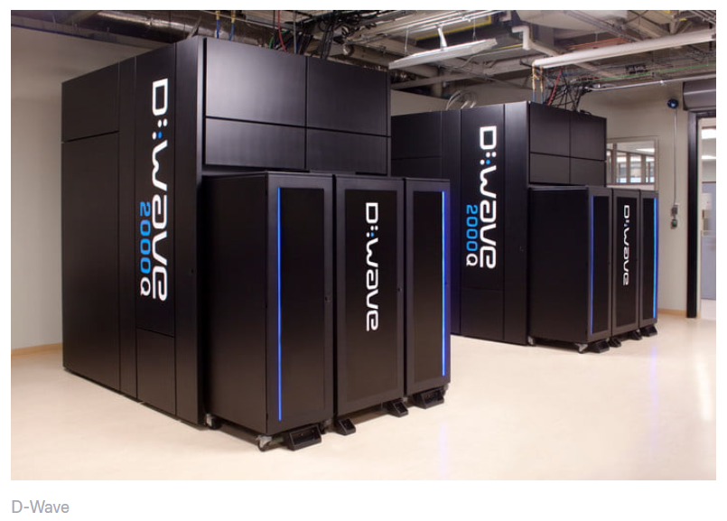

The set packing problem
While the gate quantum computer requires problems to be expressed in terms of quantum gates,
the annealer requires them to be expressed in the language of operation research ones.

Slide 4
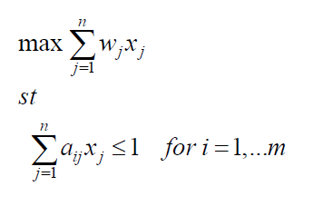
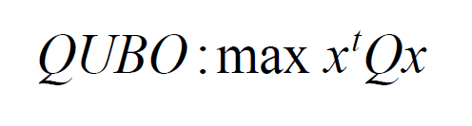

The set packing problem: Glover formalization
The Set Packing problem is a well-known optimization
Problem.
Goal: finding the best set of variables that satisfy
The objective function fitting each constraint
$w_{J}$ = weights. They represent the importance given
to each variable
$a_{i,J}$ = 1 if the corresponding variable has been chosen, 0 otherwise
One of the most famous problem classifiable as set packing problem
is the Facility Location Problem
Glover: the Set packing Problem
Glover: QUBO formulation

Slide 5
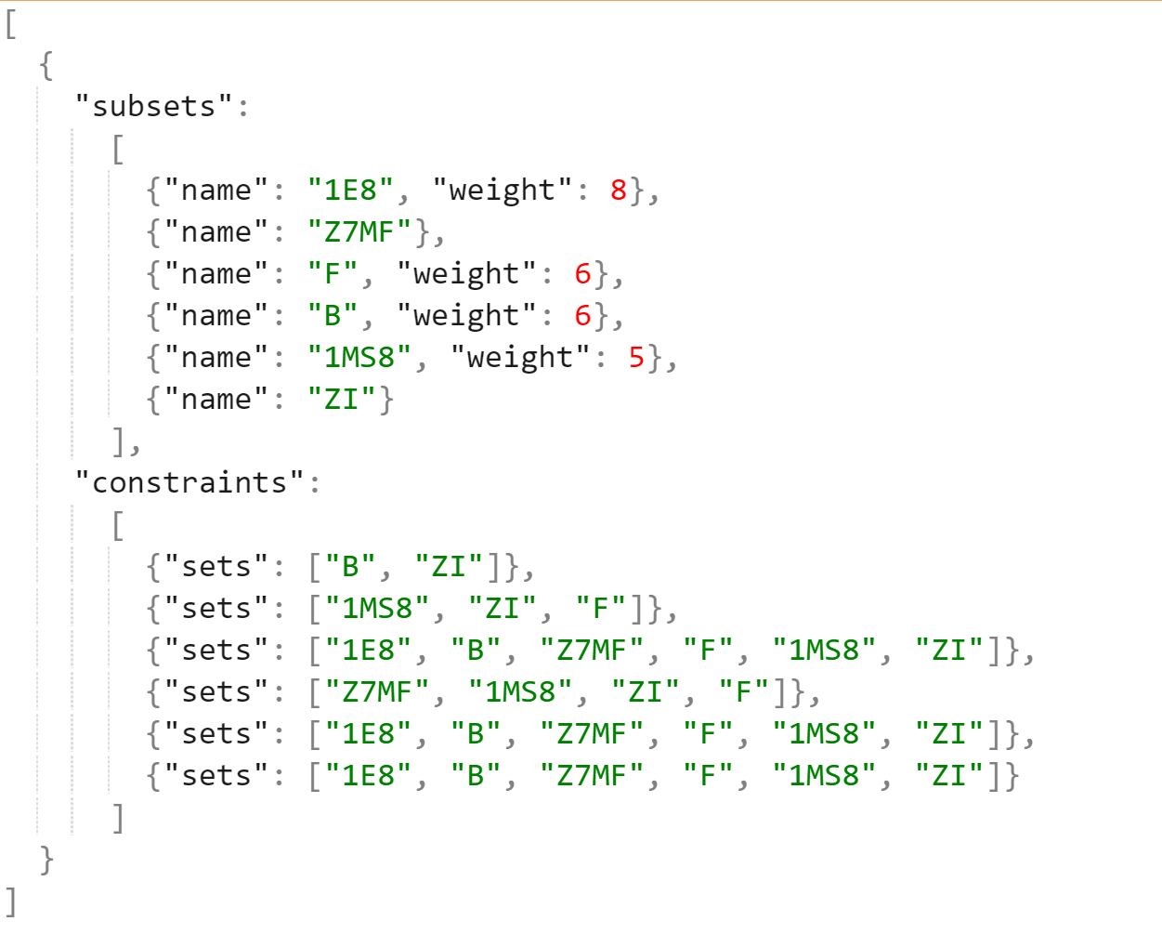
The problem generator
A generator of random set packing problems has been used to analyse different instances.
Since there was not an already existing format, a new one has been created and the chosen format is the Json one, since it is perfectly manageable using common python libraries.
Written in python,the problem generator allows creating randomly a proper instance of the set packing problem by writing it on an external file. This file, which is a .json file, is used by the algorithm to read data about the problems.
Thanks to this generator, It was possible to evaluate several instances of the problem with different variables/constraints, increasing the computational effort and thus testing each sampler’s performance.

Slide 6
The tools used: Advantage and 2000Q
2000Q
The D-Wave 2000Q system has a footprint of approximately 10' x 7' x 10' (L x W x H).
Its physical enclosure houses sophisticated cryogenic refrigeration, shielding, and I/O systems
to support a single thumbnail-sized QPU.
Most of the physical volume of the system is required to accommodate the refrigeration system
and to provide easy service access.
For quantum effects to play a role in computation, the QPU requires an extreme, isolated environment.
It works at a temperature of 15 mK and it has up to 2048 qubits and 6016 couplers.
ADVANTAGE
The Advantage™ system is the first and only quantum computer designed for business.
It is the 5th generation Advantage quantum computer that was built from the ground up with
a new processor architecture with over 5,000 qubits and 15-way qubit connectivity,
empowering enterprises to solve their largest and most complex business problems.
The main strength of the advantage Is the higher number of qubits, which makes it computationally more powerful
than the 2000Q while the main drawback is the high noise which affects its data.

Slide 7
In the first step of the project, a single experiment has been made both for the 2000Q and the Advantage platforms, with the number N of generated subsets varying from 1 up to 60 (for 2000Q) and 150 (for Advantage) The time and space complexities have been measured, together with the maximum chain length.
Phase 1: A single experiment

Slide 8
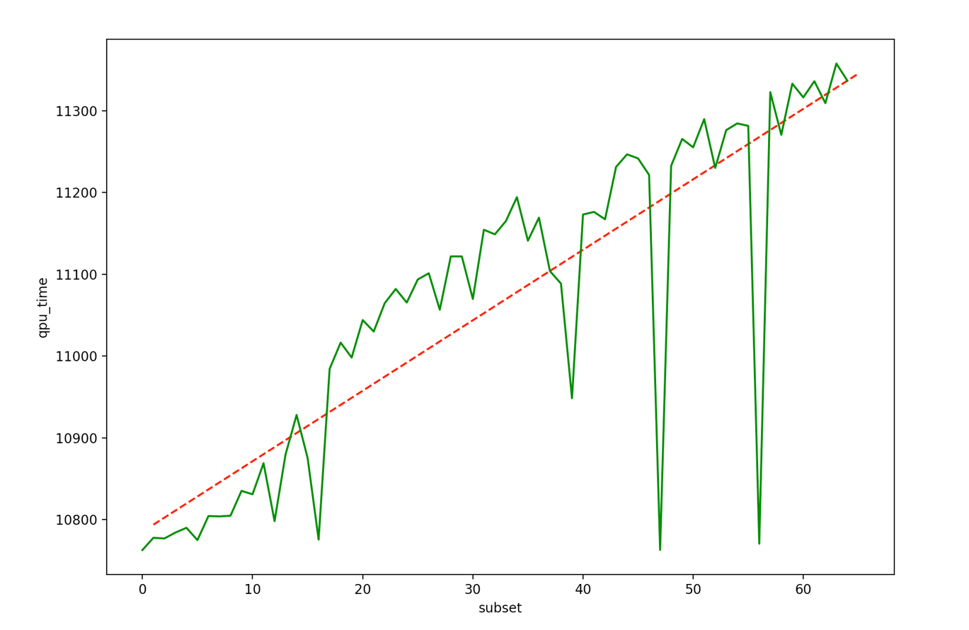
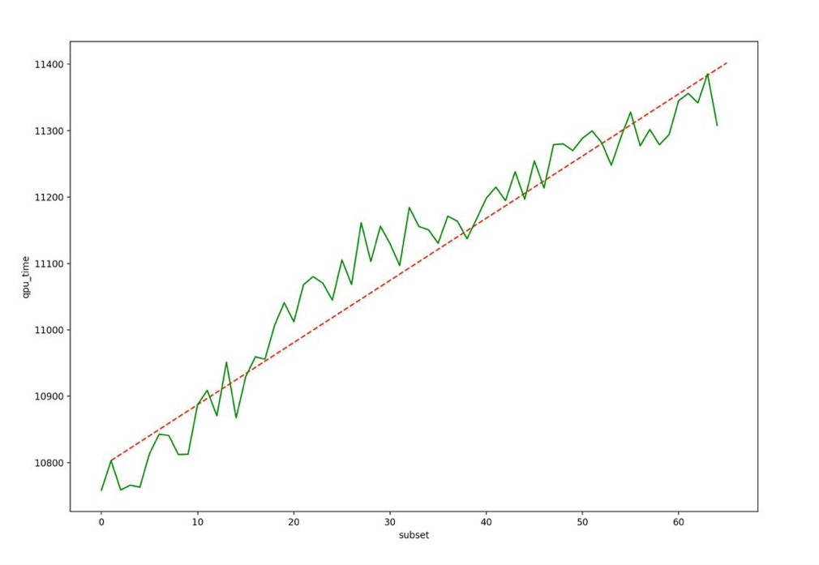
2000Q plot and results: time complexity
As it can be noticed, time increases concerning the number of subsets defined in the problem.
Occasional outliers in timing results are not unusual, because of noise from the operating system and runtime environment.
Here two different sequences of experiments are shown, the former presenting outliers, the latter with a more regular trend.
QPU time, in milliseconds, required to compute N subsets

Slide 9
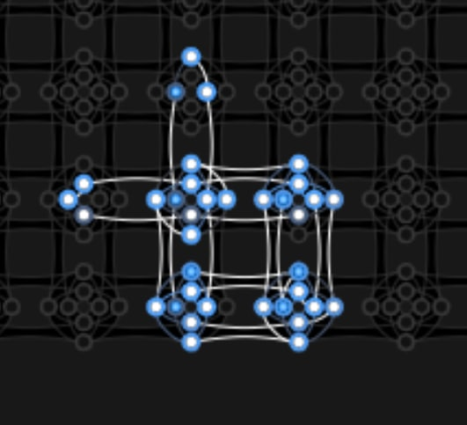
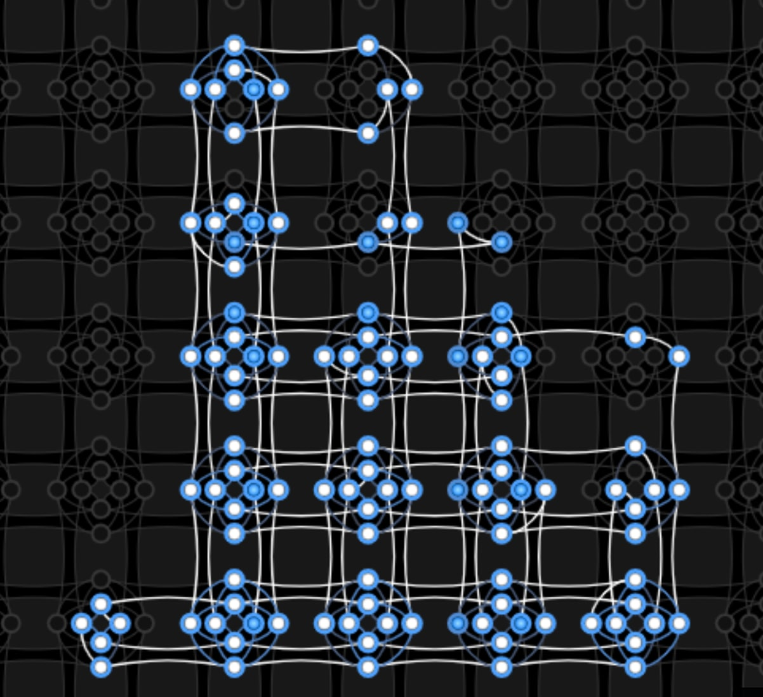
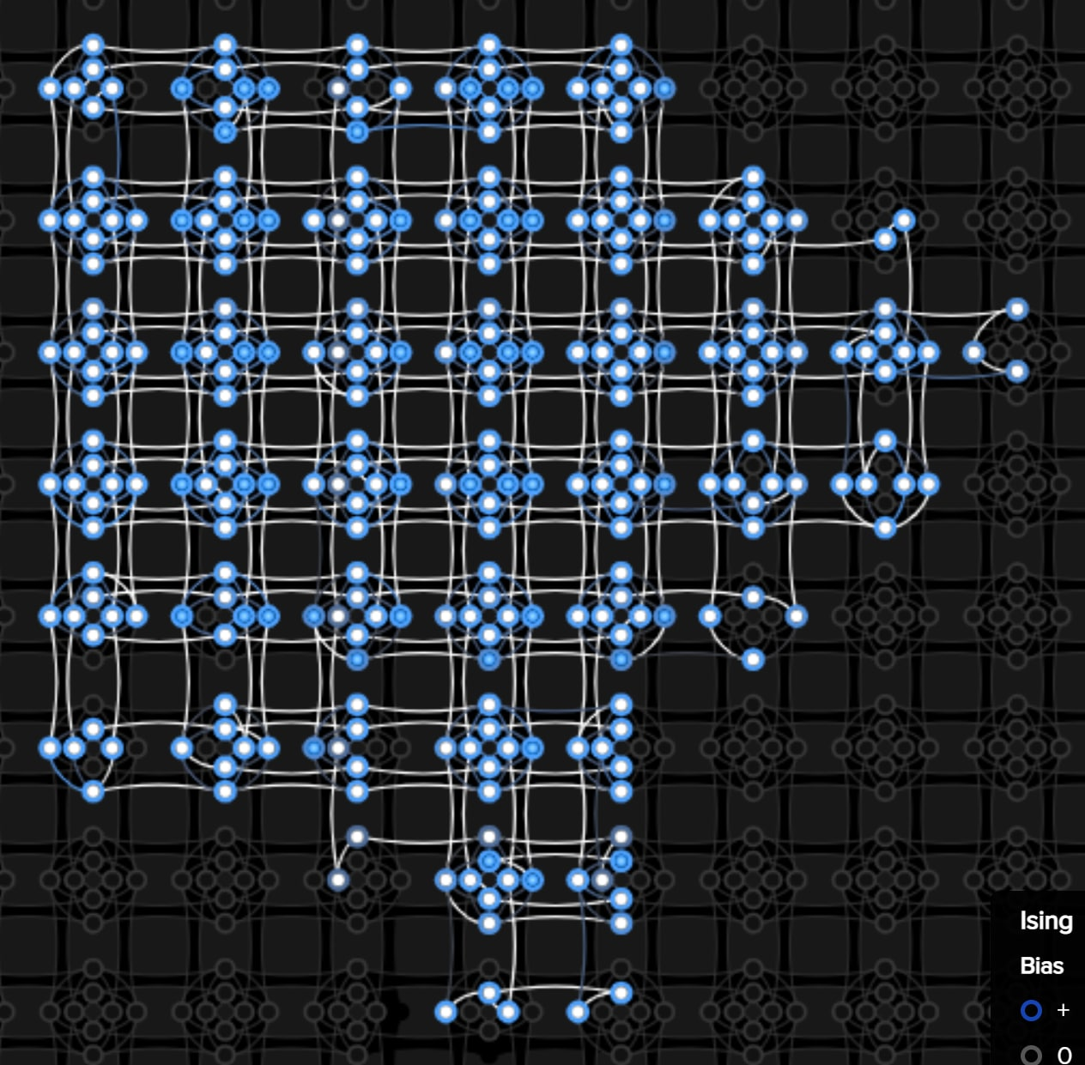
2000Q plot and results: spatial complexity
N = 10
Max chain length: 4
N = 20
Max chain length: 7
N = 30
Max chain length: 12

Slide 10
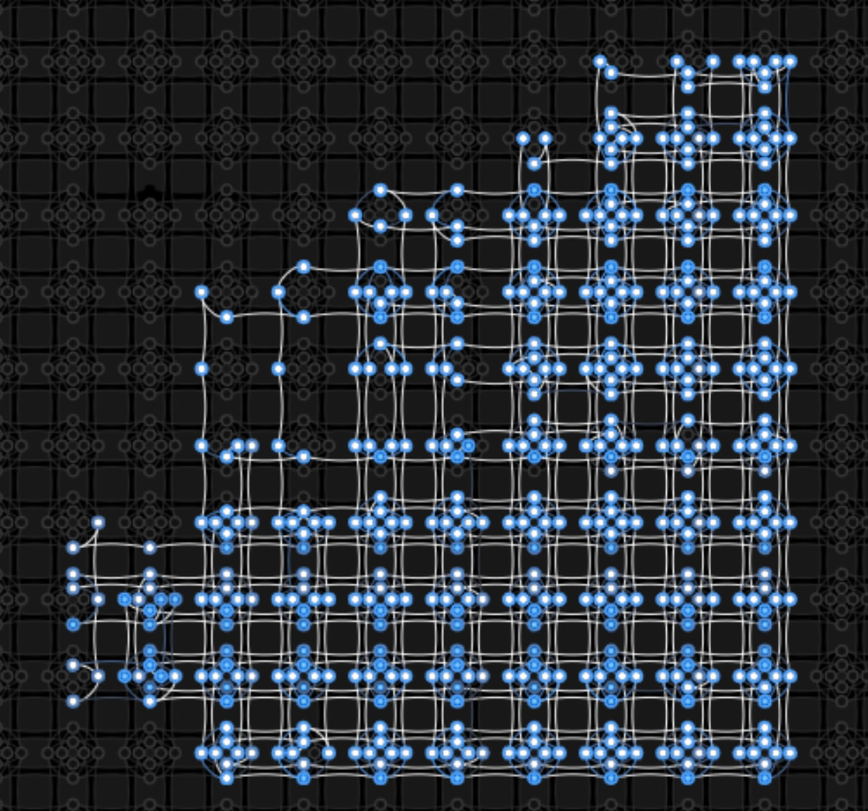
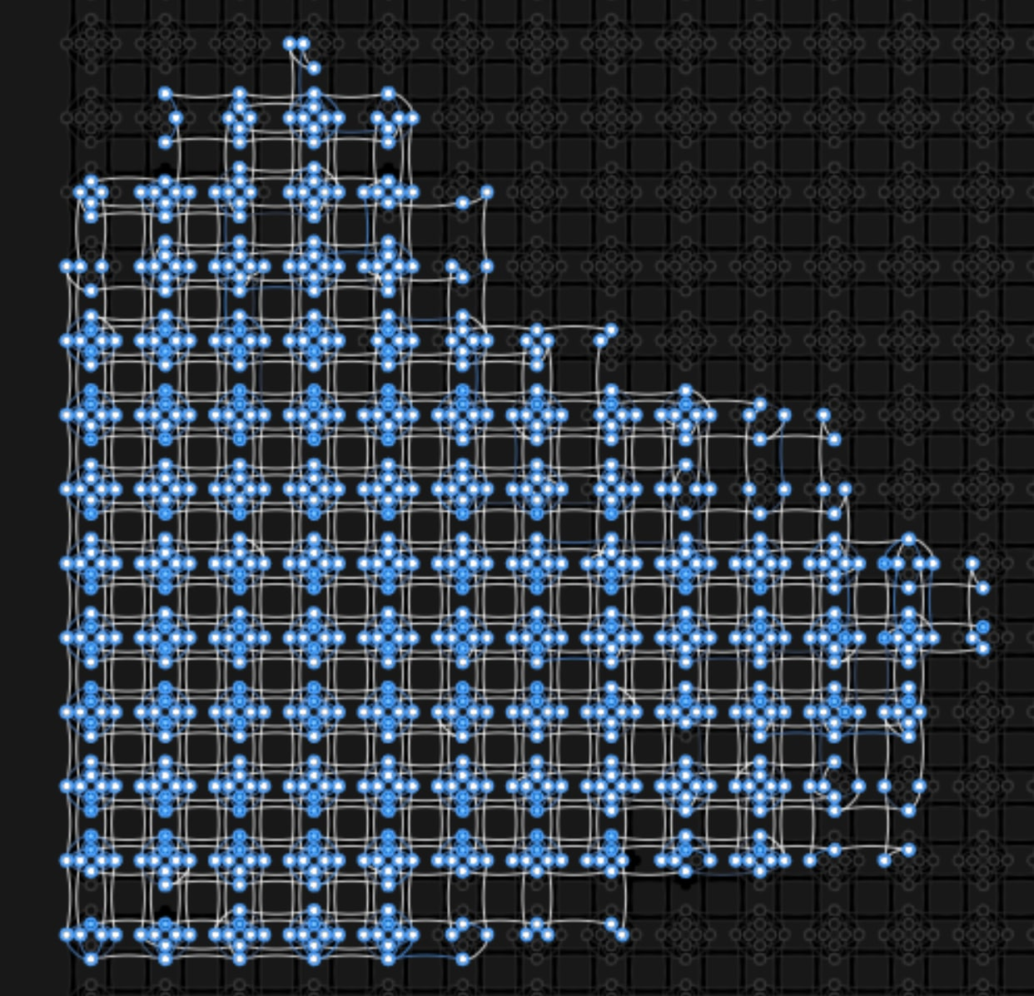
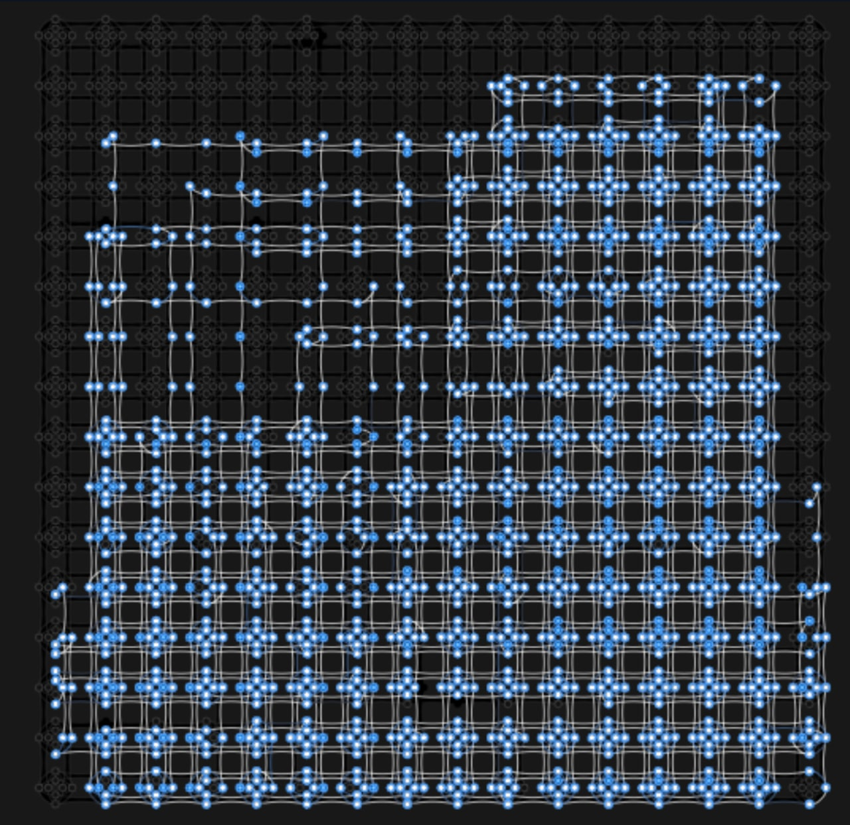
2000Q plot and results: spatial complexity
N = 40
Max chain length: 15
N = 50
Max chain length: 21
N = 60
Max chain length: 31

Slide 11
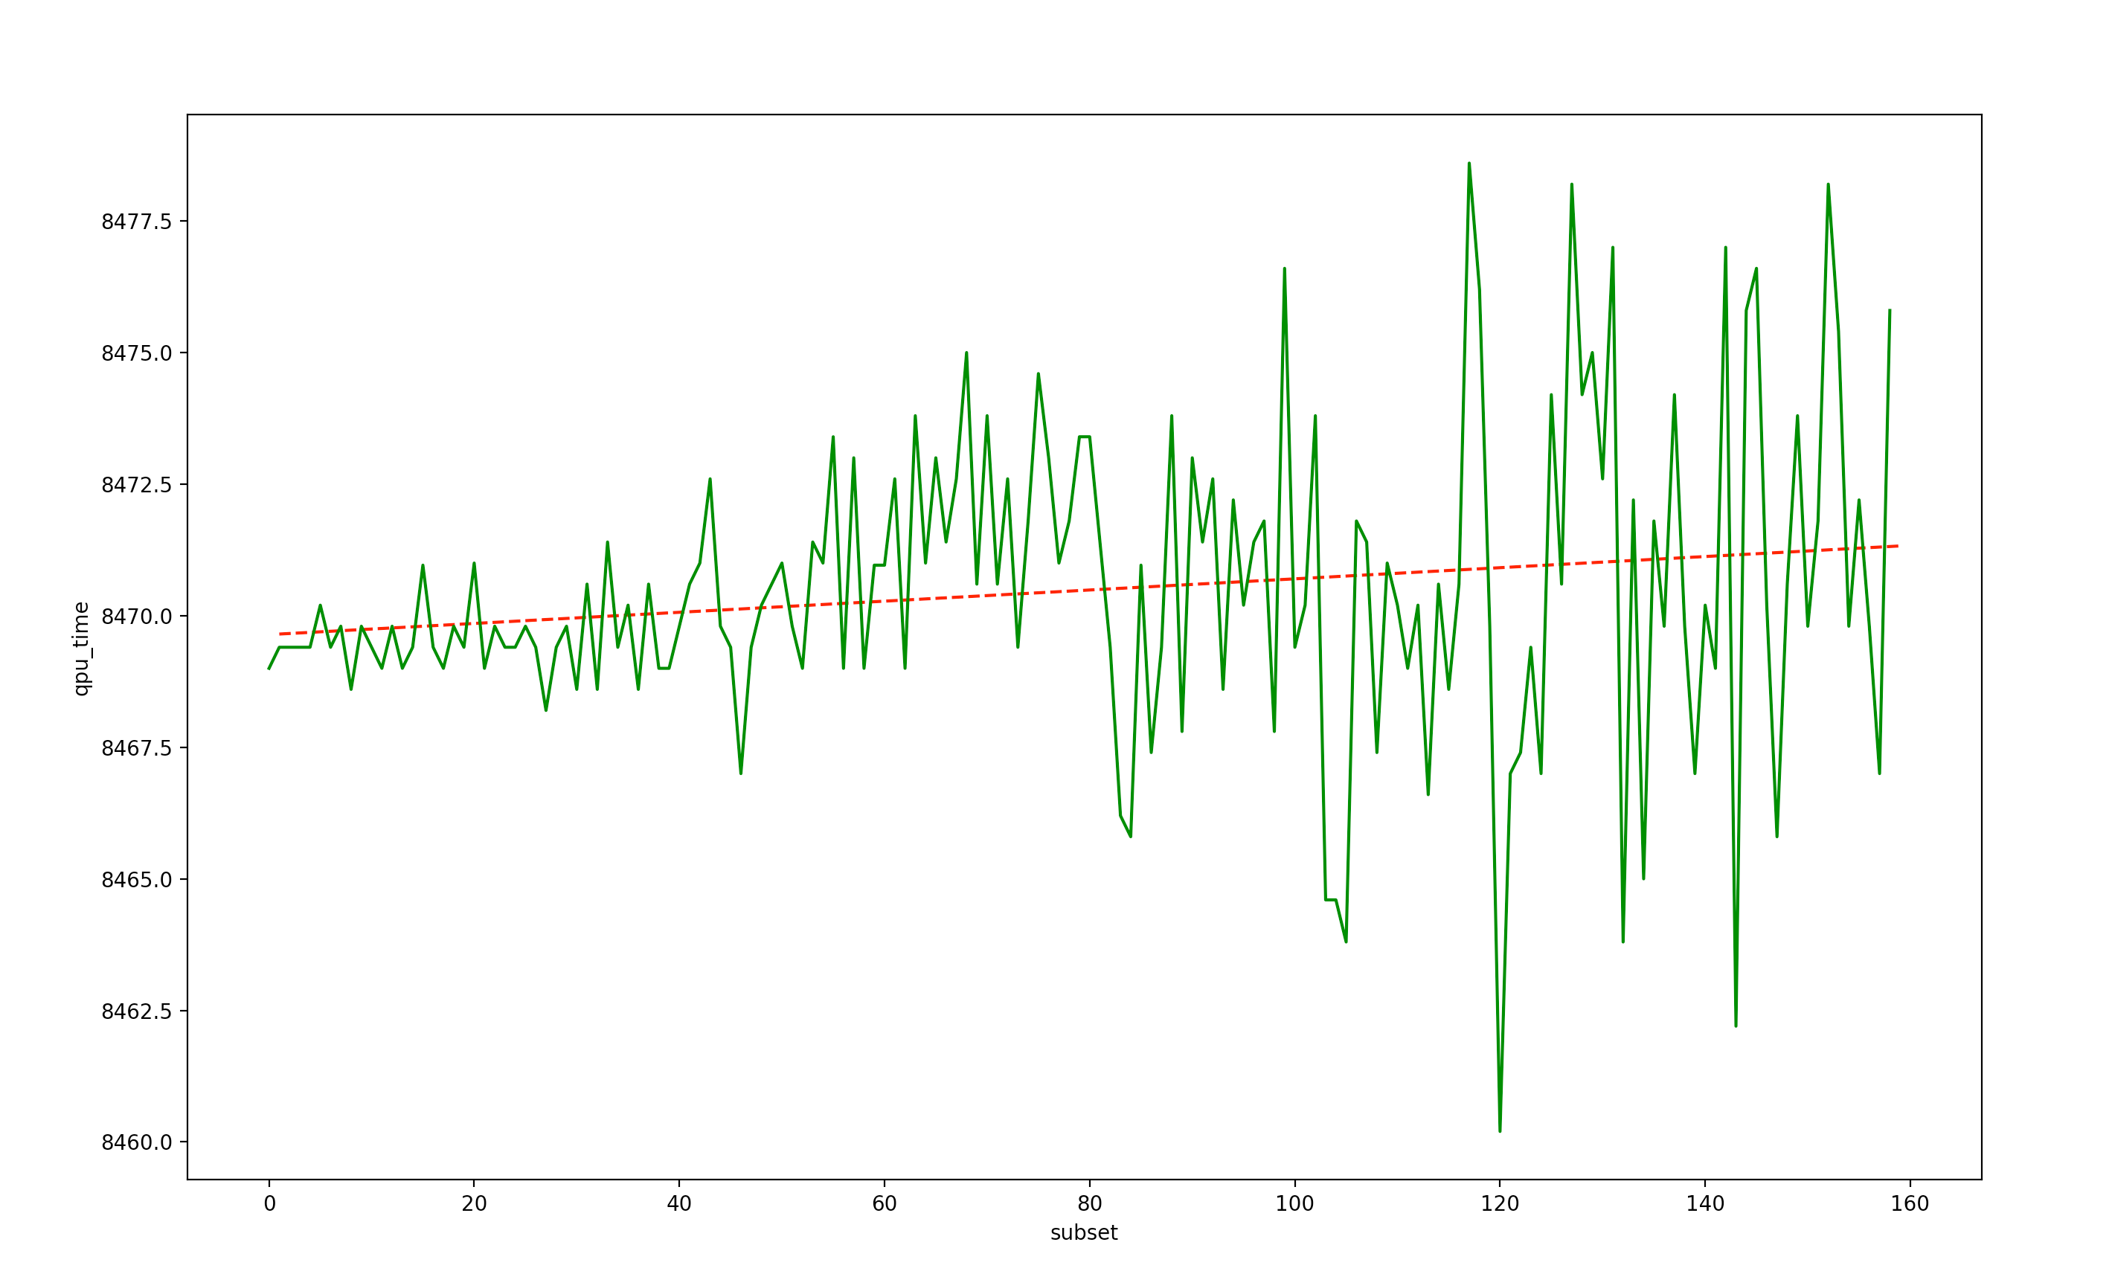
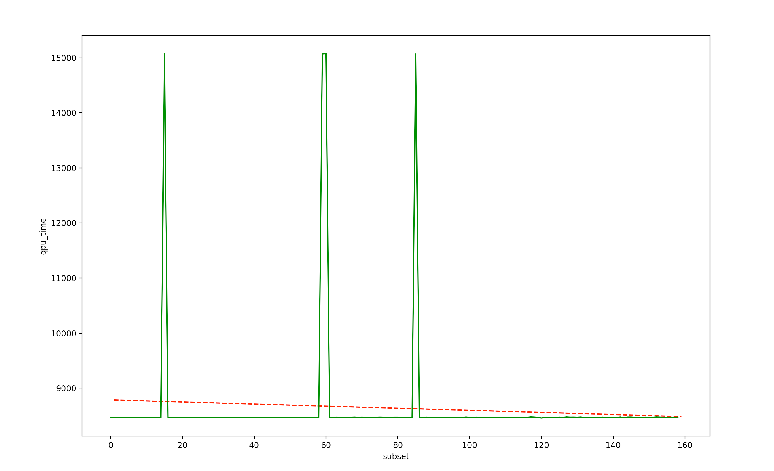
Advantage plot and results: time complexity
As it can be noticed, time increases concerning the number of subsets defined in the problem.
Also, in this case, there can be noticed several outliers.
The general trend is clearly less regular than the 2000Q timing, because of the presence of a greater amount of noise.
QPU time, in milliseconds, required to compute N subsets

Slide 12
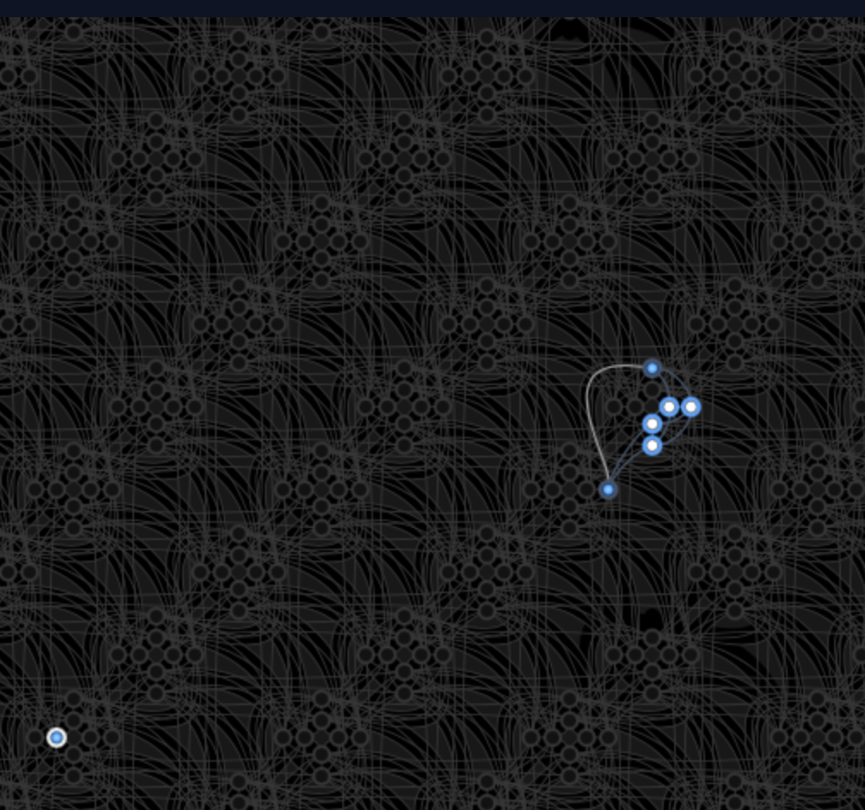
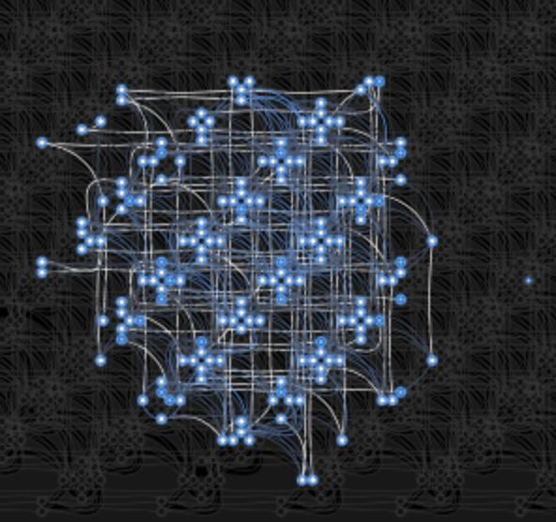
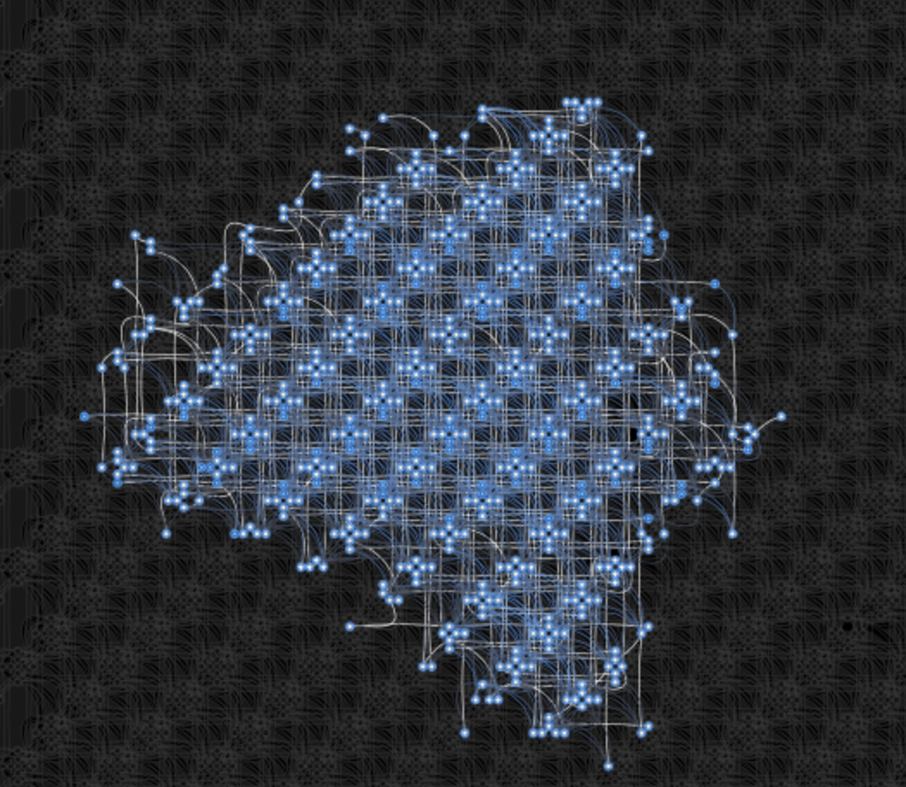
Advantage plot and results: space complexity
N = 10
Max chain length: 2
N = 40
Max chain length: 7
N = 70
Max chain length: 13

Slide 13
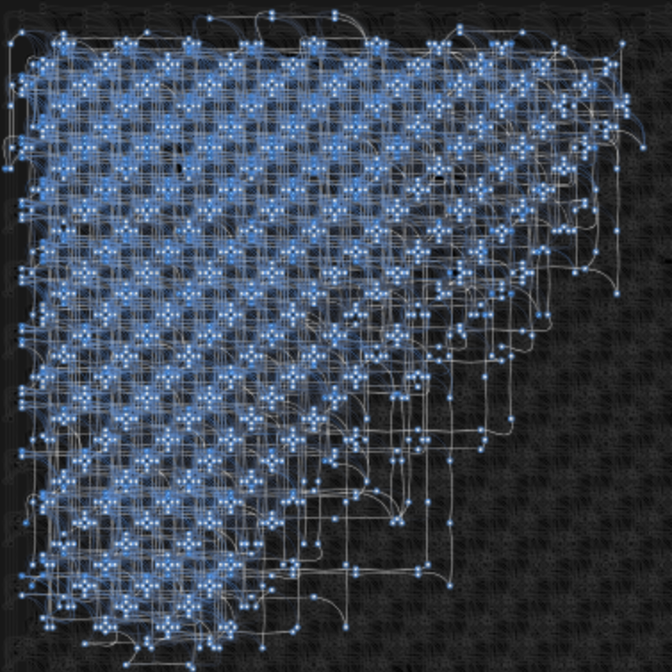
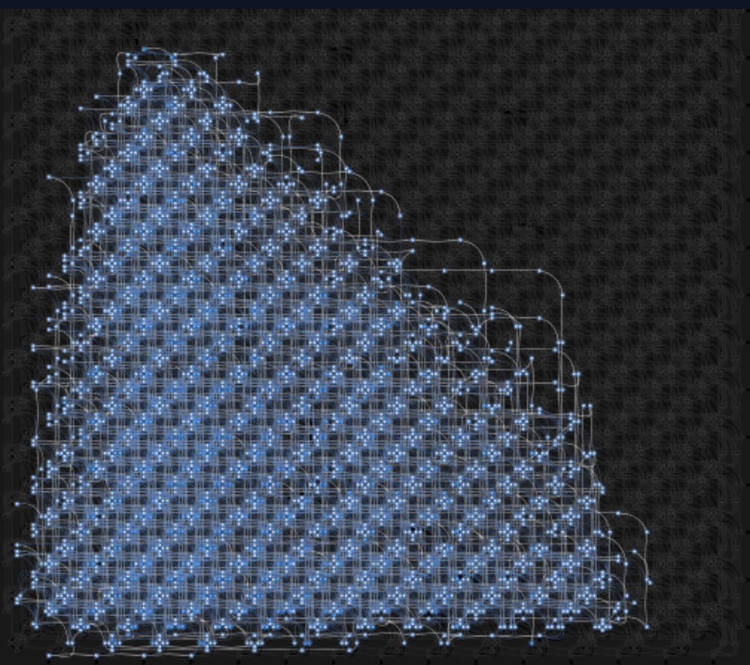
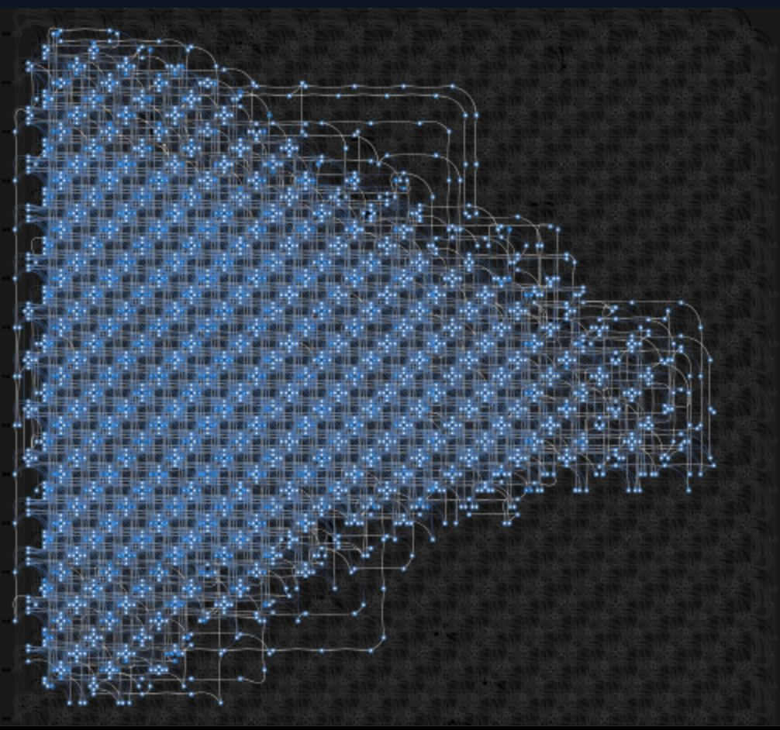
Advantage plot and results: space complexity
N = 100
Max chain length: 29
N = 130
Max chain length: 29
N = 150
Max chain length: 32

Slide 14
A brief comparison
Time Complexity
For what concerns time, Advantage results to be faster than 2000Q.
The increase in time duration results to be, in general, quite regular, even though some outlier spikes appear, as a response to noise.
Space Complexity
For what concerns space, because of the greater amount of qubits (5000 in the Advantage vs 2048 in the 2000Q), Advantage allows to solve problems with a higher value of the N parameter.
Additionally, a slightly higher maximum chain length has been noticed in the Advantage as well.

Slide 15
Phase 2: More experiments
In the second step of the project, more experiments have been run, in order to get more reliable info. In addition, for each experiment, the parameter num_reads, that represents number of samples asked to the solver, has been set to 100.
The chain strength has been modified as well, in order to get the minimum possible amount of chain breaks. The time and space complexities have been measured.

Slide 16
Reducing the amount of chain breaks
In order to reduce the amount of chain breaks, the chain strength has been set by using the value returned by the method uniform_torque_compensation, which computes the chain strength that attempts to compensate for torque that would break the chain.
Such a method requires the tuning of the parameter pre_factor, whose default value equals to 1.414, in a maximum range of [0.5, 2.0]. By doing several experiments, the optimal value, for which the minimum number of chain breaks has been found, results to be 2.0 .
Negative effects coming from the choice of a too low or too high chain strength value are discussed in (4).

Slide 17
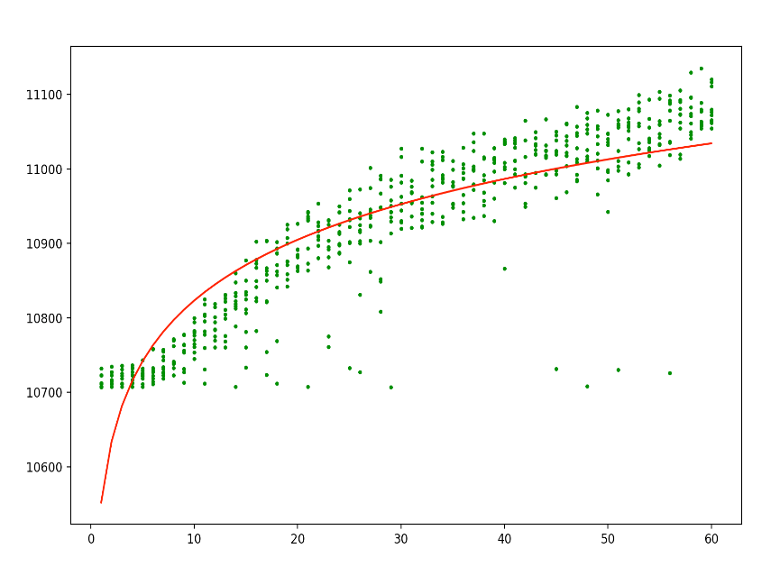
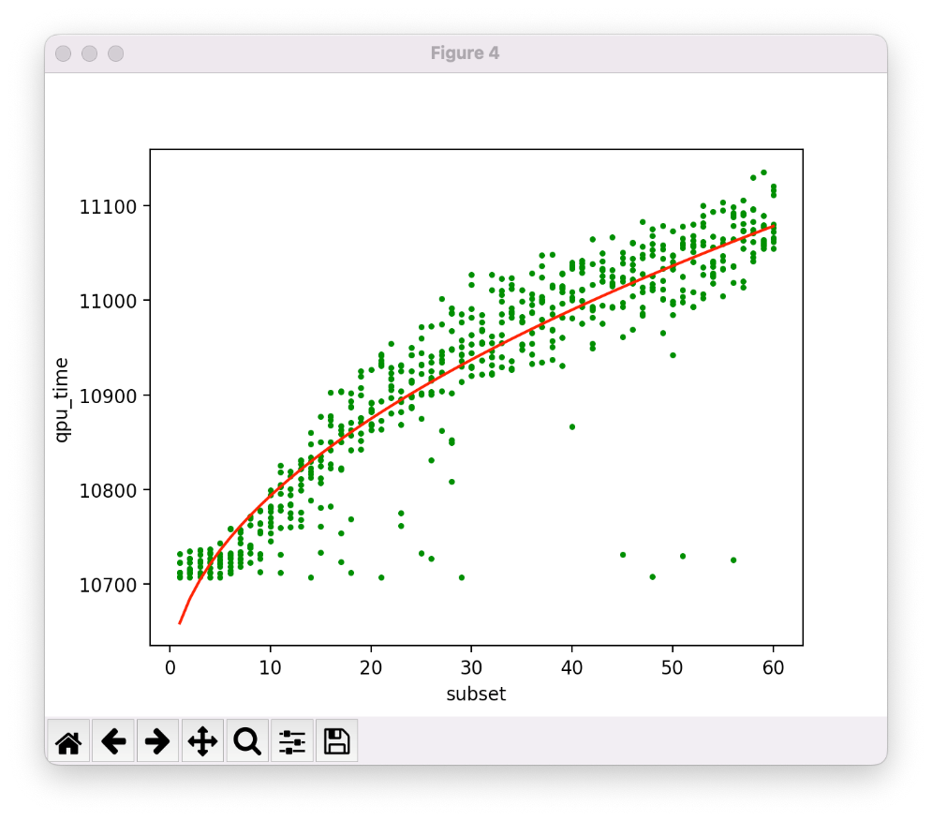
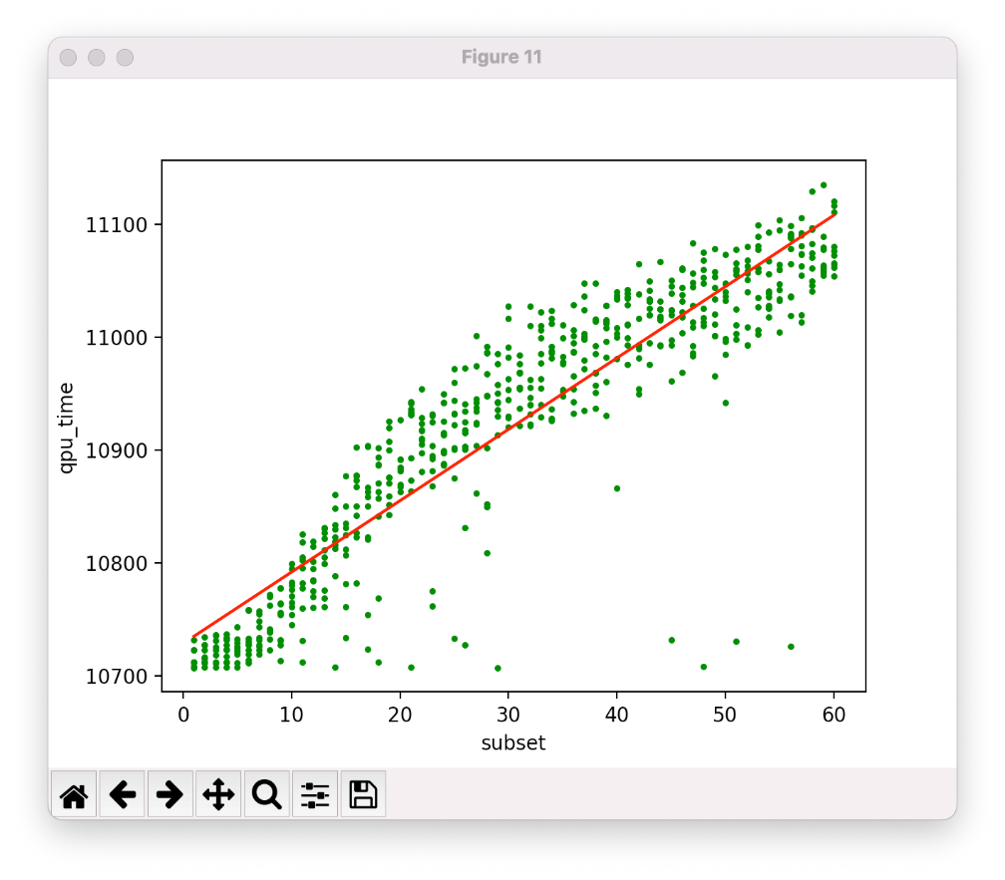
2000Q time complexity: possible fittings
QPU time = O(N)
R2 = 0.9448
QPU time = O(log(N))
R2 = 0.8830
QPU time = O(sqrt(N))
R2 = 0.9727

Slide 18
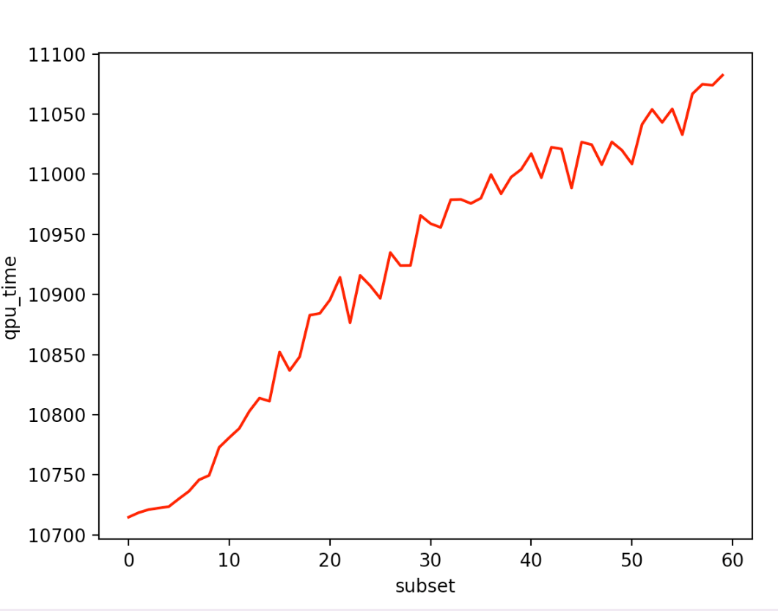
2000Q time complexity: time mean
In this plot the mean QPU time is shown.
As it can be noticed, time increases as a function of the number of subsets defined in the problem.
The general trend presents some irregularities due to the noise, but in general it follows the square root of N, as explained before.
QPU mean time, in milliseconds, required to compute N subsets

Slide 19
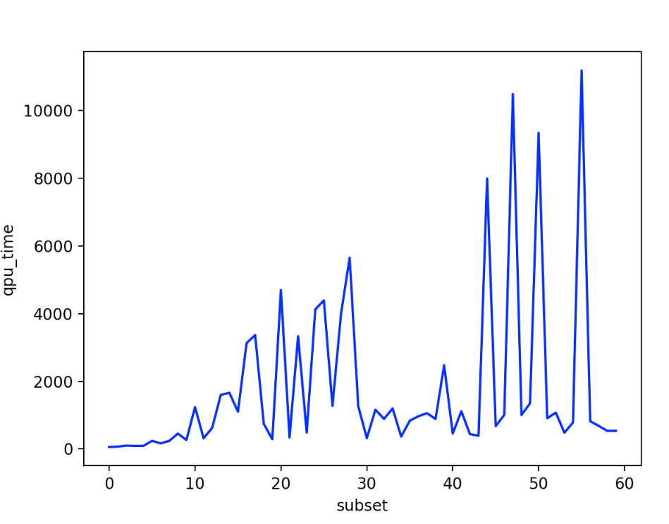
2000Q time complexity: time variance
In this plot the variance of the QPU time is shown.
As it can be noticed, variance increases as N gets higher, even though its trend results to be very irregular.
Variance of QPU time in milliseconds

Slide 20
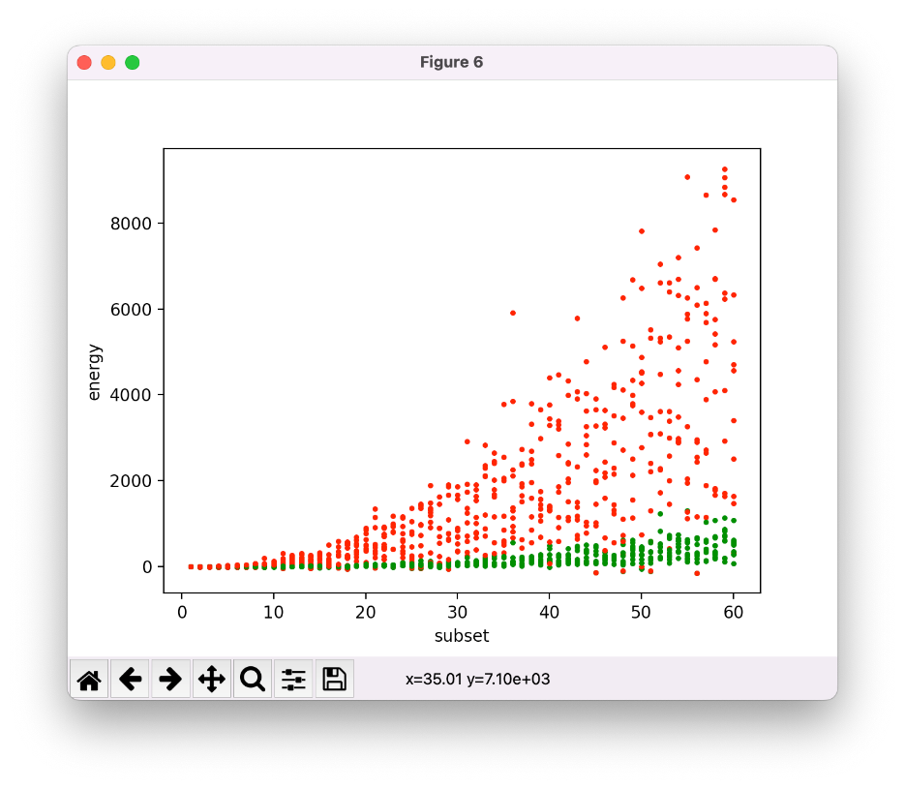
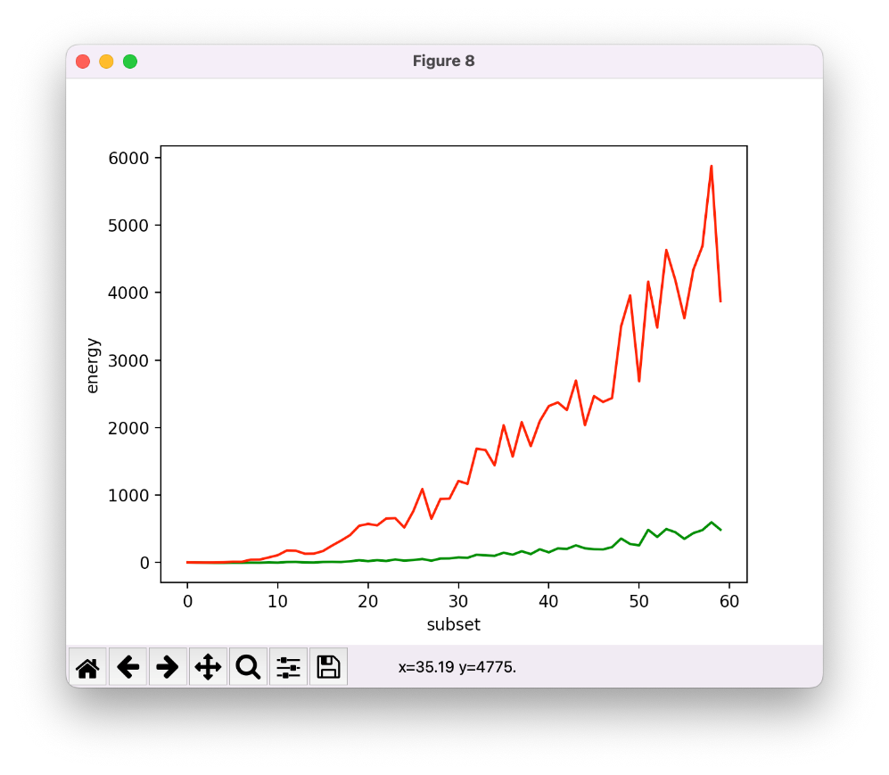
2000Q: Maximum and minimum energy
In these plot the maximum and minimum values for energy are represented.
In particular, in the first plot values are shown for all the experiments that have been done.
In the second plot mean values are shown.

Slide 21
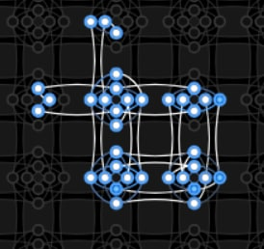
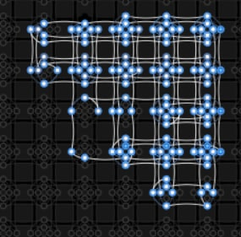
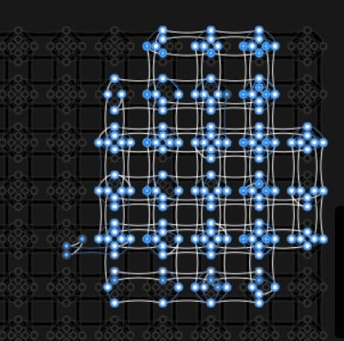
2000Q plot and results: space complexity
N = 10
max chain length: 4
chain strength = 120.72
physical qubits = 33
N = 20
max chain length: 8
chain strength = 95.47
physical qubits = 132
N = 30
max chain length: 9
chain strength = 52.21
physical qubits = 178
# of chain breaks for these experiments: 0

Slide 22
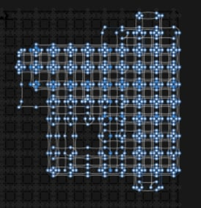
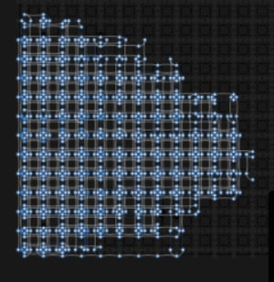
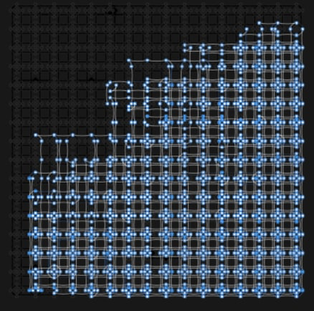
2000Q plot and results: space complexity
N = 40
max chain length: 17
chain strength = 273.18
physical qubits = 528
N = 50
max chain length: 25
chain strength = 701.68
physical qubits = 888
N = 60
max chain length: 33
chain strength = 1285.3
physical qubits = 1295
# of chain breaks for these experiments: 0

Slide 23
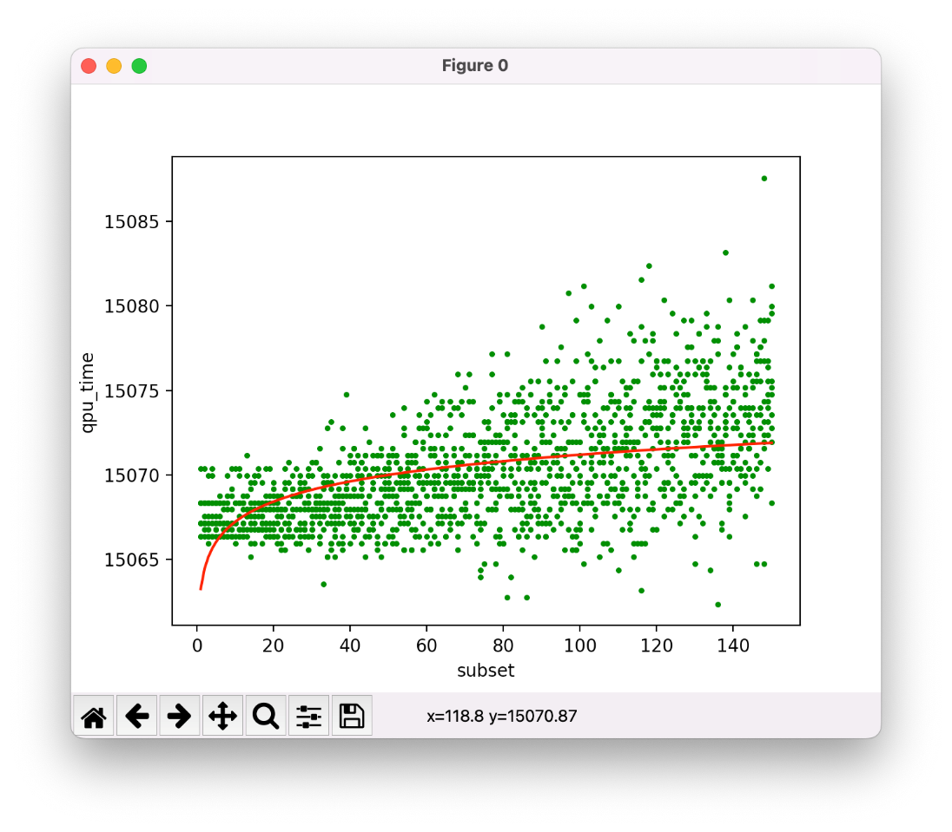
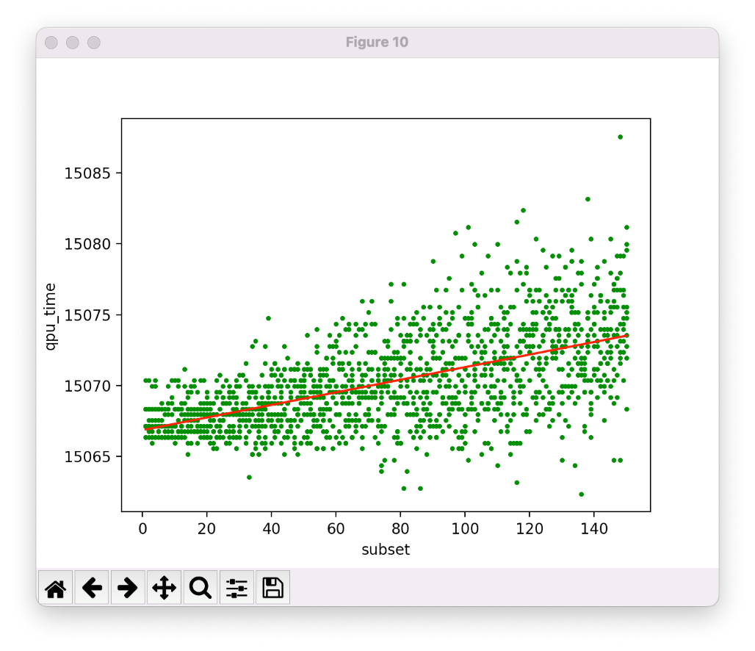
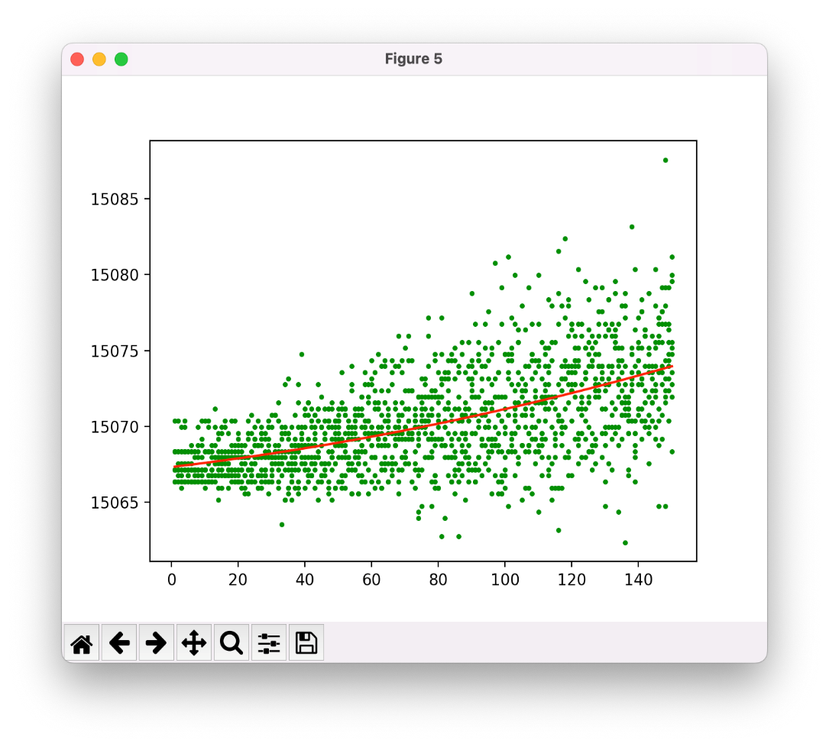
Advantage time complexity: possible fittings
QPU time = O(N)
R2 = 0.8575
QPU time = O(log(N))
R2 = 0.6113
QPU time = O(sqrt(N))
R2 = 0.7914

Slide 24
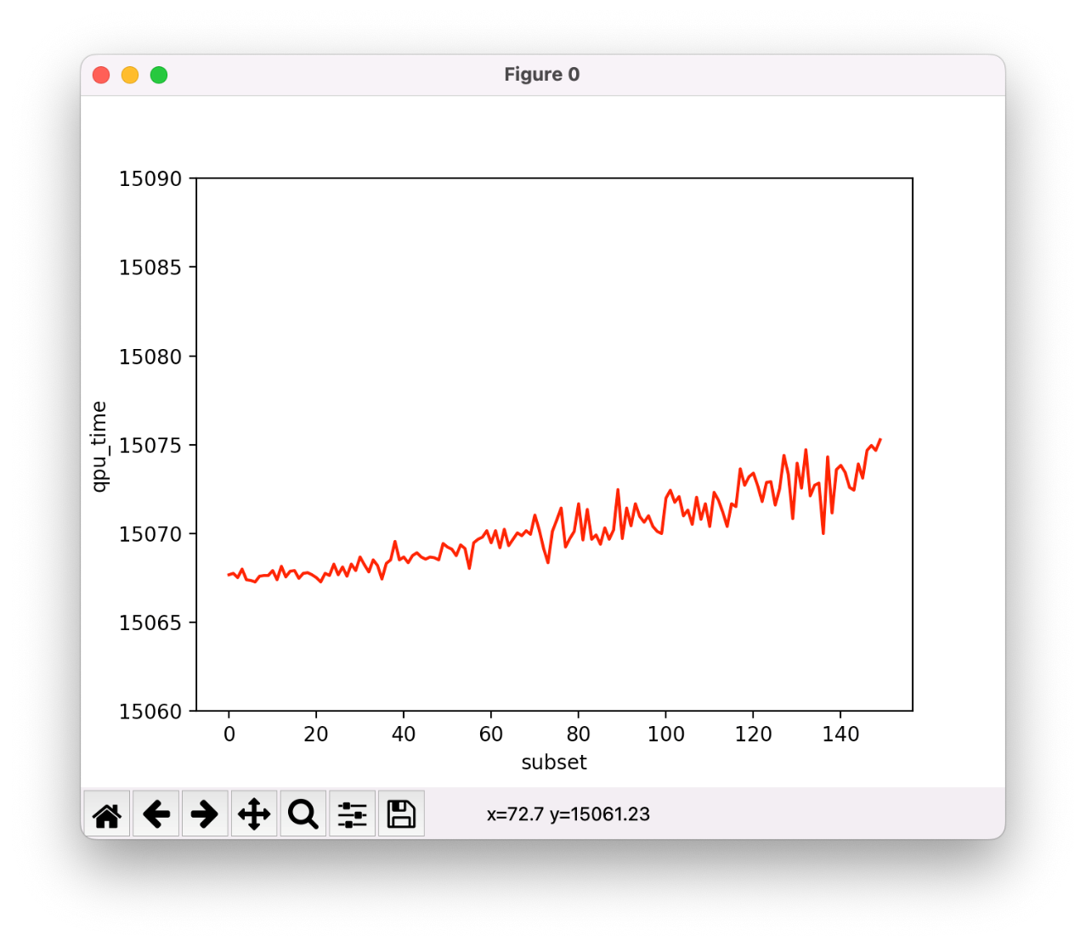
Advantage time complexity: time mean
In this plot the mean QPU time is shown.
The mean time for advantage increases with a slower pace than 2000Q, and in general it results to be quite regular, even though noise is present.
QPU mean time, in milliseconds, required to compute N subsets

Slide 25
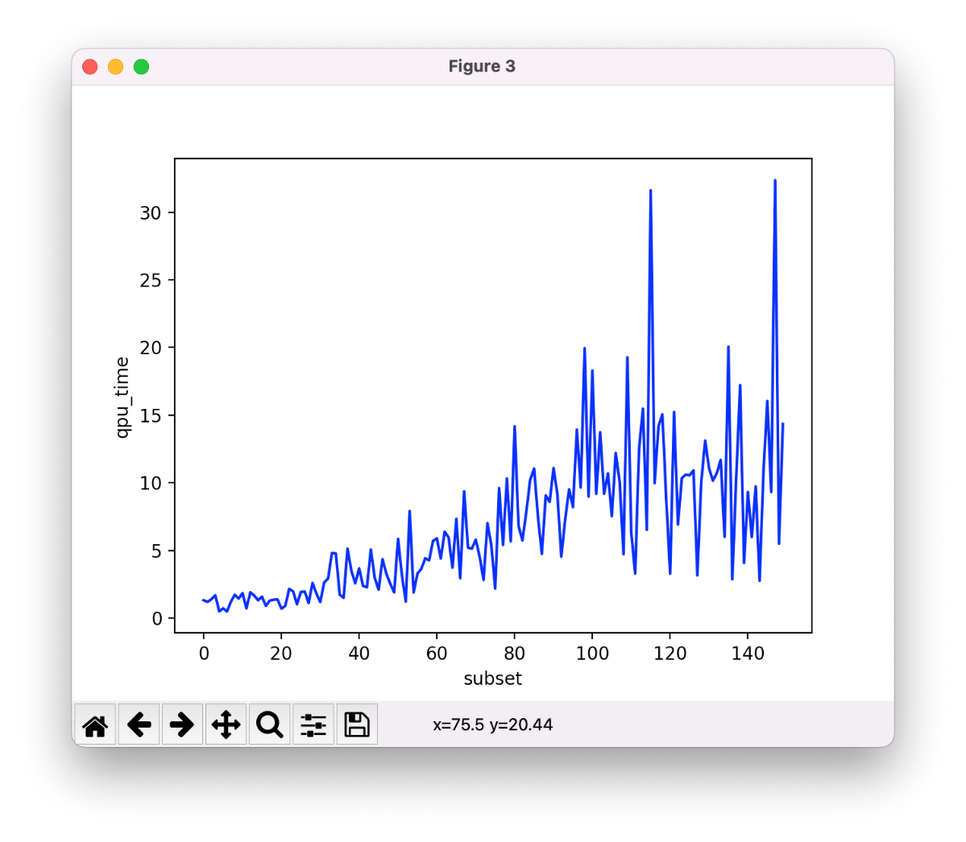
Advantage time complexity: time variance
In this plot the variance of the QPU time is shown.
As it can be noticed, variance increases with the number of subsets, and in general its trends is very irregular.
Variance of QPU time in milliseconds

Slide 26
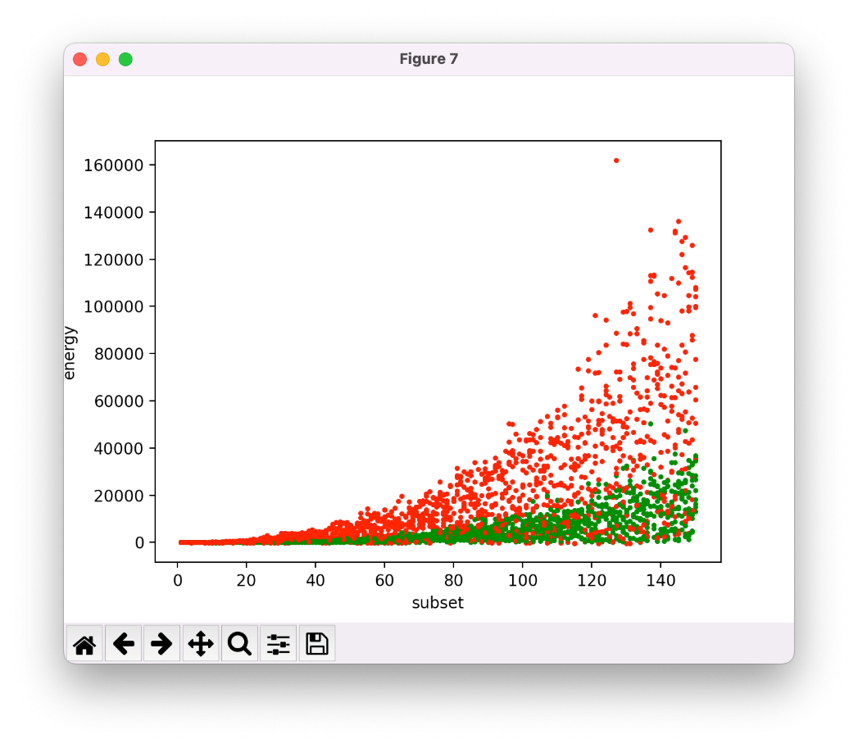
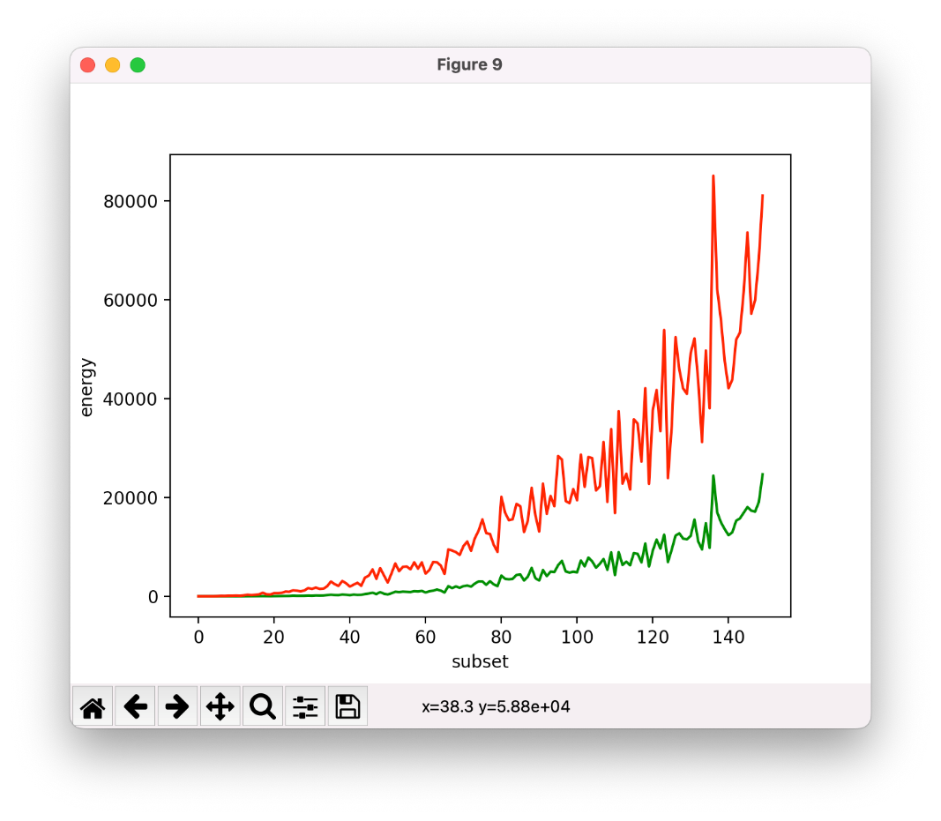
ADVANTAGE: Maximum and minimum energy
The first plot shows the values for maximum and minimum energy obtained during the experiments of advantage.
The second plot shows the mean values for maximum and minimum energy.

Slide 27
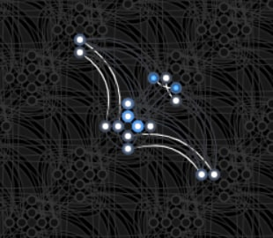
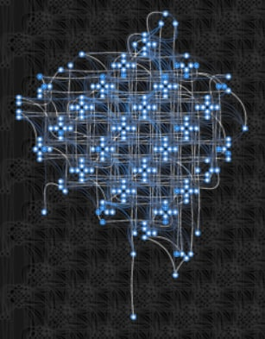
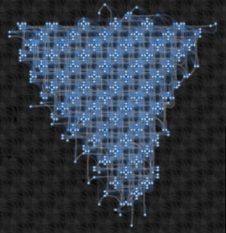
Advantage plot and results: space complexity
N = 10
max chain length: 2
chain strength = 100.40
physical qubits = 16
N = 40
max chain length: 7
chain strength = 114.09
physical qubits = 206
N = 70
max chain length: 11
chain strength = 1839.19
physical qubits = 553
# of chain breaks for these experiments: 0

Slide 28
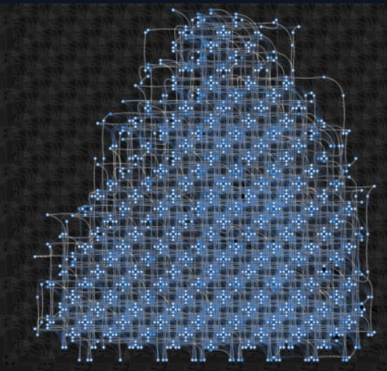
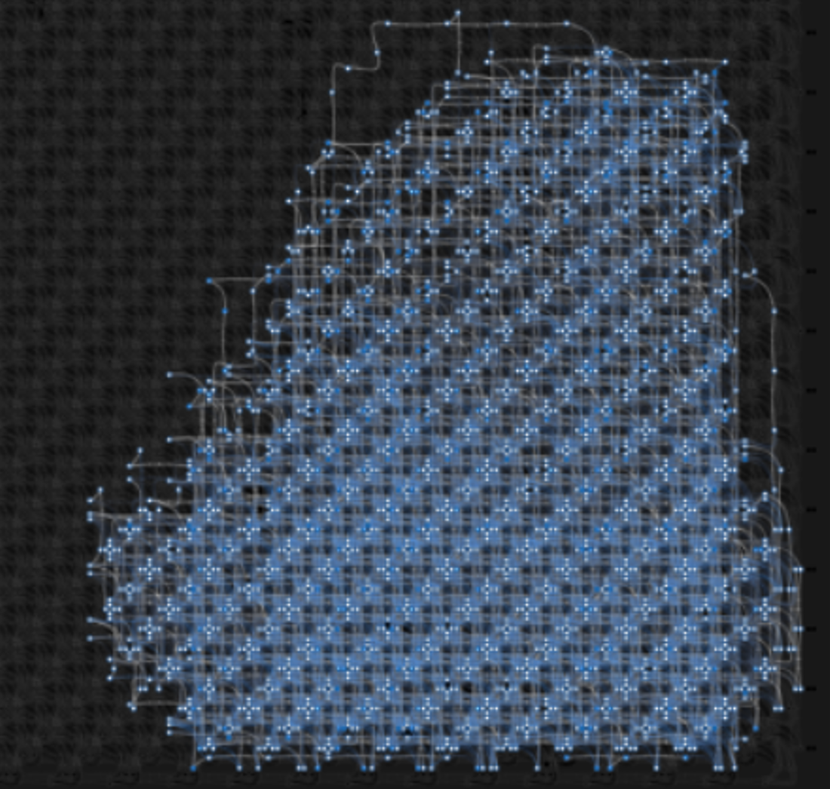
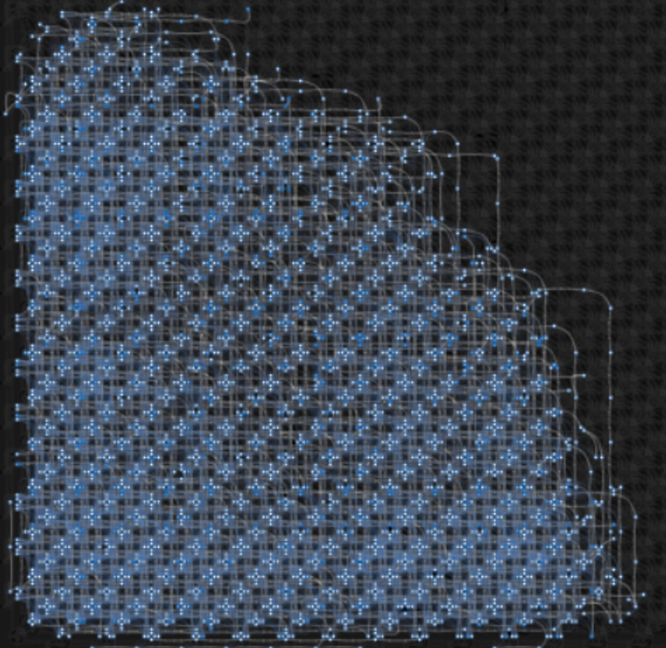
Advantage plot and results: space complexity
N = 100
max chain length: 19
chain strength = 2722.51
physical qubits = 1324
N = 130
max chain length: 28
chain strength = 3011.24
physical qubits = 2356
N = 150
max chain length: 34
chain strength = 2350.35
physical qubits = 3309
# of chain breaks for these experiments: 0

Slide 29
The final result
Time Complexity
In general, QPU time spent to solve such problems increases as the square root of the number N of considered subsets. The pace of the mean time for advantage is slower than 2000Q, and this result is consistent with the better performance associated to the Advantage platform. Noise affects both the mean and the variance. The increase of num_reads and chain strength has had an impact on time, producing higher values with respect to phase 1.
Space Complexity
For what concerns space, the greater amount of qubits in the Advantage allows for more complex problems to be solved. By tuning the chain strength, it has been possible to nullify the number of chain breaks in the considered problems, while the maximum chain lengths result to be similar for both platforms.
Energy
In addition, values for maximum energy are one order of magnitude higher for the Advantage, with respect to the 2000Q. Such values have been reached thanks to a higher chain strength.

Slide 30
References
https://dwavejapan.com/app/uploads/2019/10/D-Wave-2000Q-Tech-Collateral_1029F.pdf
https://docs.dwavesys.com/docs/latest/c_qpu_annealing.html
https://docs.dwavesys.com/docs/latest/c_gs_2.html
https://www.dwavesys.com/media/vsufwv1d/14-1041a-a_setting_the_chain_strength.pdf

